Slide 1
Mathematics Teacher Standards and Lesson Study
How do you define good teacher?
Researcher is teacher.
If it is correct, how do you diffine good teacher.
Masami Isoda
PhD (Waseda U.) & h.c PhD,(Khon Kaen U)
Professor of Mathematics Education
CRICED, University of Tsukuba, Japan.
at
SEAMEO-RECSAM and University of Tsukuba Joint Symposium, February 16, 2015.
Teacher is researcher.
If it is correct, how do you diffine good teacher.

Slide 2
Sets of Questions
What is the good teacher?
Why we can say it is the definitions/ frameworks of good teacher?
Why we need the regional instead of national?
Why we do not discuss difference?
Direction of more deeper: Elementary, Secondary, University: is it the same?
Direction how to use: At pre-service and in-service, how to develop qualified teachers?

Slide 3
Teacher Standards
Dimension 1: Professional Knowledge
Dimension 2: Professional Teaching and Learning Process
Dimension 3: Personal and Professional Attributes
Dimension 4: Professional Communities
Lesson study develop learning community. However what do they learn?

Slide 4
Teacher Standards
Dimension 1: Professional Knowledge
Dimension 2: Professional Teaching and Learning Process
Dimension 3: Personal and Professional Attributes
Dimension 4: Professional Communities
They should learn four dimensions through lesson study
Teacher
Mathematics + Objective = Content for Teaching (Sub. M)
Lesson study is learning community. What shall they learn?
Students
Content
Subject M.
The science for reproduce better practice for children.
JP Lesson Study Oriented:
Teacher C. A.<Students C. A.<Content C. A.
JP LS based on Hermeneutics:
Getting other’s perspective < Getting various p.

Slide 5
LS project for developing subject matter (1993-2004)
With technology (ICT): 1993-1998
With historical text: 1998-2004
One year project by 14 MS students, every year.
  Learning last year products from students
  Reading and searching content with Isoda
  Developing teaching content by and for themselves
  Engaging in teaching classes by team (students, teachers and me) with survery
  Producing the project report including their survey.
Dimension 1: Professional Knowledge
Dimension 2: Professional Teaching and Learning Process
Dimension 3: Personal and Professional Attributes
Dimension 4: Professional Communities

Slide 6
Rind Papyrus Problem (Arcavi, Isoda 2007)
Hermeneutics: The theory for interpretation for getting others perspective.
Isoda, M. (2002). Hermenautics for Humanizing Mathematics Education, Tsukuba Journal of Educational Study in Mathematics. Vol.21. 1-10.
Isoda’s History Project Website:
http://math-info.criced.tsukuba.ac.jp/Forall/project/history/index.html
http://math-info.criced.tsukuba.ac.jp/museum/Mathematics_tools/index.htm

Slide 7
Aims and schedules on the Lesson Study project with History and Technology
The Lesson Study project aimed to develop materials for giving high school students cultural awareness in mathematics, improve their attitudes and brief in mathematics by conducting lessons, and to demonstrate the educational value of the developed materials. The schedule to engage in the Lesson Study in the school year 2001 was as the following;
Phase 1) Transition period (almost April – June):
Teacher educator (project director) explained first-year students a year plan of the project and explained what kinds of activities were expected. Second-year students in master program who engaged in last year’s projects conduct new first-year students’ classes to review the activities from their actual lessons on the previous year’s project. First-year students learned how to use the computers in their Lesson Study from second year students and began the project.
Phase 2) Reading of historical sources in mathematics (almost July – August): Students read historical textbooks (English readings or Japanese translations of primary sources) for excavating teaching materials and A History in Mathematics Education (John Fauvel, Jan Van Maanen. 2000) for learning the educational value and teaching methods of mathematics history. Teacher educator supported their reading, made clear interesting points when compared with today’s mathematics and excluded the misinterpretation originated from reading mathematics history books with today’s mathematics such as Bourbaki..

Slide 8
Aims and schedules on the Lesson Study project
Phase 3) Subject matter development (almost September – November): Students developed subjects from historical texts, conceptualized lessons, established aims and goals, and developed teaching materials such as textbooks using original (or English translation) texts, slides and activities with computer. Teacher educator helped to find interesting materials from historical texts and supported students to develop structures of textbooks and lessons.
Phase 4) Lesson implementation (almost November – December):
Students conducted the lesson. Teacher educator supported students to expect classroom students’ activities, especially classroom students’ responses and how teachers can use the response. Teacher educator also supported how to use classroom equipments such as projecting students’ notebook activities to the screen for sharing students’ ideas in the classroom.
Phase 5) Report preparation (almost December – February):
Students wrote their research reports, created their web site. Teacher educator supported their references depending on their research problems and also supported their preparations for presentations among the mathematics education society.
After the phase 5, for knowing prospective teachers’ experience and for knowing didactical meaning of each phases, the researcher asked to represent how they changed through the project into the graph of emotions.

Slide 9
Methodology 1 (Isoda: PME2000)
Graphs of Emotions; Drawn by students & Hart Rate
x-axis: time scale is given by drawer.
y-axis: free by drawer.
Comments are given by drawer.
After phase 5, we asked prospective teachers.

Slide 10
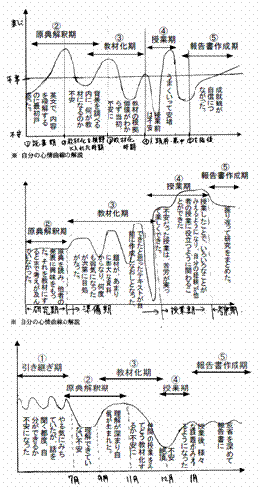
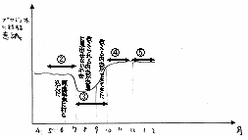
Results
Appendix 2
Even if each person’s y axis meaning is very different, the phases are well reflected on their graphs
The periods
~
are rewritten in relation to Phase 1~5, not as same as original periods written by the persons.
Appendix 3
Appendix 1
Appendix 4
Appendix 5

Slide 11
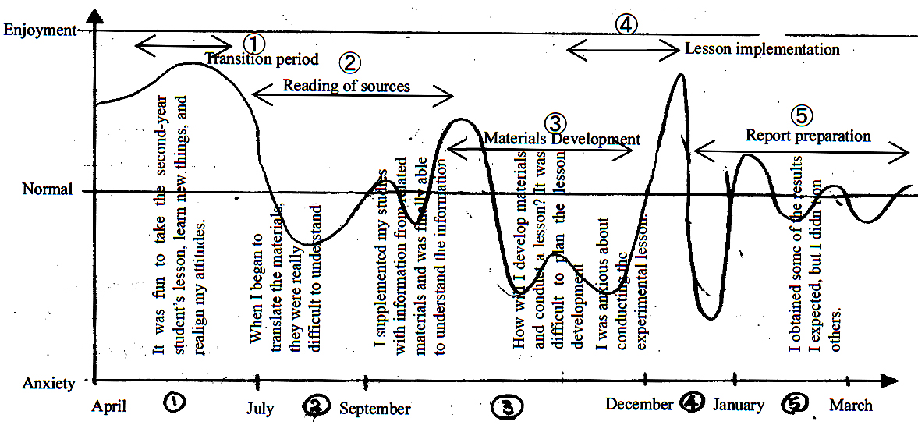
An interpretation of experience in a case prospective teacher: How can we interpret?
Depending on emotional theory by George Mandler (1984) based on the Piajetian cognitive model, emotional arousal is related with obstacles and challenges, and results such as overcoming obstacles give positive emotional feed backs. This cognitive cycle until reflection is also reasonable from the educational meaning of experience described by John Dewey. Based on Mandler’s meaning of emotional change, we can interpret one down-up in the graph recognized as a strong experience.
Figure 1. A Case of one prospective teacher’s experiences in the project

Slide 12
Reference
Abraham Arcavi and Masami Isoda, Learning to listen: from historical sources to classroom practice, Educational Studies in Mathematics, Vol. 66, No. 2, The History of Mathematics Education: Theory and Practice (October, 2007), pp. 111-129
Masami Isoda（2007）, Lesson Study in Teacher Education Programs: How do Students Become Teachers That Implement Lesson Study? In Isoda et al edited. JAPANESE LESSON STUDY IN MATHEMATICS Its Impact, Diversity and Potential for Educational Improvement, Singapole: World Scientific (pp176-179).
Isoda (2006). NESTING FEATURES OF DEVELOPING TEACHERS’ PERSPECTIVES: A LESSON STUDY PROJECT FOR PROSPECTIVE TEACHERS IN MATHEMATICS WITH HISTORY AND TECHNOLOGY Masami Isoda University of Tsukuba, Japan。APEC KKU conference, 2006. http://www.crme.kku.ac.th/APEC/PDF2006/file5Masami%20Isoda.pdf
Isoda, M., Nakagoshi, A.(2000) A case study of student emotional change using changing heart rate in problem posing and solving Japanese classroom in mathematics,Edited by Nakahara, T., Koyama, M., Proceedings of the Conference of the International Group for the Psychology of Mathematics Education 24th, Hiroshima University Vol. 3, 87-94.
礒田正美（2007）、教育経験から発達課題とその意義を認めるもう一つの目標研究 : 数学史教材開発過程での心情記述に現れた学生の視野の転換を例に．数学教育論文発表会論文集 35, 1-6, 2002-11-23

